Slide 1
Summative Clinical Competency Exam Class of 2024 February 28– March 17, 2023

Slide 2
General Instructions for SCCX
Detailed instructions on website.
Please read them before you arrive on your first exam day
If you have any questions, feel free to email Mary (maiello@siumed.edu)

Slide 3
Exam Composition
2 days, 6 cases each day
12 CCX cases
(20 min SP encounter, 45 min CCX)
All case problems from Must See Objectives for Graduation: common complaints, not necessarily common diagnoses
Schedules are on CCX Assessment website

Slide 4
Overview: Behavior
Arrive 10 minutes before your 1st case
Sign confidentiality statement
Pharmacopoeia is only reference allowed
No food/drink in computer lab
Honor code applies
Do not talk about cases anywhere.
Do not leave PDL area during exam period.
Do not use cell phones or computers.
Do not bring or wear a Smart watch.

Slide 5
Overview: Exam Room Logistics
Bring own stethoscope or borrow from PDL
Task is specified on Door Chart (and you may take it in room with you)
Approach each patient as the physician in charge of diagnosis and the ongoing care of the patient.
Use your initial DDX to direct your questions and exams.
If you retake vitals and they are different from chart, use the ones on the chart.

Slide 6
Overview: SP Room reminders
Be prepared to start on time.
Use Head to Toe PE guidelines for physical exam (including listening/palpating on skin).
Cards only given AFTER physical exam component is completed
Camera serves in lieu of chaperone.
There will be a 5 minute warning chime.
Close visit appropriately.

Slide 7
Overview: Computer Lab Logistics
Proctors are there to HELP…use them if needed.
A few older Pharmacopoeia copies available.
If you have computer problems, let the proctor know.
Leave your notes in the shred box on proctor table when finished.

Slide 8
How SCCX is Different…
Cases are drawn from..
All organ systems
All core clerkships
All Doctoring curricula
Performance expectations are based on the standard of care for the complaint, not other students.
Not all cases follow a diagnostic model: read the presenting and be prepared to listen to the patient.
Reading the door chart will be included in timed encounter.

Slide 9
How SCCX is Different…
Findings
Must interpret vitals, do not just list them
(e.g., VSWNL ≠ no fever)
DxJ
Will only complete Preliminary DxJ (before labs)
Labs
If asked to interpret, describe what you see
Order only those labs needed. Just because you can order tests does not mean you should.
SP Checklist
No points given for History items (on the checklist SPs complete).

Slide 10
Dx Justification
Resources on CCX Assessments website
DxJ Scoring form
Dx Justification Tips
Space limit - 2900 characters, approximately 400 words, with count-down counter
Jeanne Keller SCCX practice case updated and available at https://siumed.dxrccx.com/

Slide 11
DDx, findings & dxJ

Slide 12
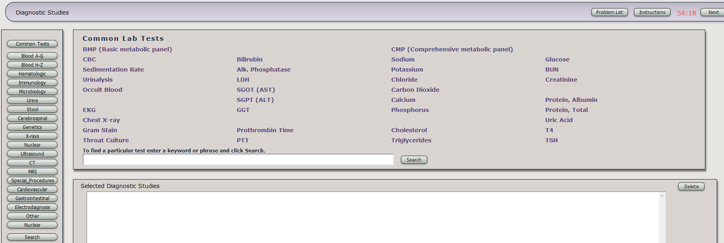
Labs & dx

Slide 13
Problem list & management

Slide 14
Scoring: How SCCX is different….
Patient Satisfaction score is independent (not part of case score: separate score across all cases)
Dx Justification is 20% of case score
Minimum passing score set across all cases
Must pass minimum number of cases to pass examination (expect 9 or more to pass)

Slide 15
Passing the SCCX
Case/SCCX Grading:
CCX cases:
20%: Diagnosis Justification
80%: H&P Checklist, Findings, DDX, Labs, DX, Problem List, TX (each single item worth 1-2% of score regardless of what it is)
Pass at least 9 cases
Patient Satisfaction Grading:
Must achieve 4’s across all items in 10 cases
Notes:
This is how we score SCCX cases: DXJ will be 20%. The rest will be equally weighted criteria points (findings, labs, etc). At least 10 cases will be needed to pass the exam. Patient Satisfaction considered separately: must be rated 80% in AT LEAST 11 of 14 cases.

Slide 16
Scoring Timeline
SCCX scored in March
Automatic review of SCCX failures
Results distributed mid-April (approx. April12, 2023)
Reports in campus mailboxes and sent to SPC simultaneously (will notify you via e-mail)
Remediation recommendations not official until SPC approves the recommendations (April 19, 2023)

Slide 17
If you do not pass….
Overall SCCX: Clinical Reasoning course 3 weeks: June 12 – June 30, 2023
Patient Satisfaction: 1 week Communication/Culture Course (Week of June 5, 2023)

Slide 18
CCX Assessments Website http://www.siumed.edu/oec/ccx-assessments.html
Notes:
There is a page on the curriculum website where materials related to the SCCX will be available: schedules, instructions, review materials… For example, these slides will be posted there for later reference.

Slide 19
If you have questions:
CCX Assessments website is located in Education & Curriculum under General Information
http://www.siumed.edu/oec/ccx-assessments.html
OR
Mary Aiello (maiello@siumed.edu)
Dr. Erica Nelson (enelson@siumed.edu)
Notes:
ANY QUESTIONS?

Slide 20
QUESTIONS?

